Slide 1
Contemporary Moral Problems
M-F12:00-1:00SAV 264
Instructor: Benjamin Hole
Office Hours: everyday after class
Email: bvhole@uw.edu

Slide 2
Agenda
Clicker Quiz
Kant

Slide 3
Schedule
Today
Next week
Pick up on objections to the universal law formulation
Discuss Humanity and Kingdom of Ends formulations
This discussion will likely bleed into next week
Pick up with the Kant
Let’s discuss Mappes before the Vatican and Corvino

Slide 4

Please set your Turning Technology Clicker to channel 41
Press “Ch”, then “41”, then “Ch”

Slide 5
Kant claims that the dictates of morality are:
always mere means to ends in themselves.
hypothetical imperatives.
categorical imperatives.
heteronomous imperatives.
rules of thumb.
all of the above.
none of the above.

Slide 6
Kant believed that humans have dignity or agency in virtue of:
their membership in the human species, homo sapiens.
their being created in the image of God.
their capacity for kindness.
their rationality and autonomy.
all of the above.
none of the above.

Slide 7
Kant claims that the moral law is given to each person by:
society.
one’s own will.
god.
the natural world.
all of the above.
none of the above.

Slide 8
Objections
Kant’s Universal Law Formulation of the Categorical Imperative

Slide 9

Rigorism
Problem: You have Nazi’s at your door asking, “Do you know where any Jews are?”
Does Kant give us the right answer?

Slide 10
The rigorism objection.
Strongly Agree
Agree
Somewhat Agree
Neutral
Somewhat Disagree
Disagree
Strongly Disagree

Slide 11

What’s the maxim?
The Sneaky Maxim Maker Objection
MacIntyre: “the Categorical Imperative imposes restrictions only on those insufficiently equipped with ingenuity”
(A Short History of Ethics, 198).
Is universalizability vacuous and conservative?

Slide 12
The Sneaky Maxim Maker Objection
Strongly Agree
Agree
Somewhat Agree
Neutral
Somewhat Disagree
Disagree
Strongly Disagree

Slide 13

Mill’s Criticism
“[Kant] fails, almost grotesquely, to show that there would be any contradiction, any logical (not to say physical) impossibility in the adoption by all rational beings of the most outrageously immoral rules of conduct … All he shows is that the consequences of their universal adoption would be such as no one would choose to incur”
(JS MILL, Utilitarianism).
Is Kant guilty of covert consequentialism?

Slide 14
The Covert Consequentialism Objection
Strongly Agree
Agree
Somewhat Agree
Neutral
Somewhat Disagree
Disagree
Strongly Disagree

Slide 15
The Humanity Formulation
Kant’s Categorical Imperative

Slide 16
Humanity Formulation
“Act so that you treat humanity, whether in your own person or in that of another, always as an end and never as a means only.”
Negative Aspect: “never as a mere means”
Positive Aspect: “always as an ends”

Slide 17
Problems for the Principle of Humanity
The Basic Problem
The notion of treating someone as an end is vague, and so the principle is difficult to apply.
The principle fails to give us good advice about how to determine what people deserve.

Slide 18
The Moral Standing Objection
Is the scope of Kant’s account of personhood too small?

Slide 19
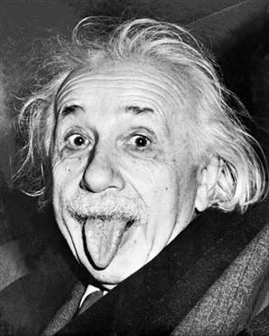

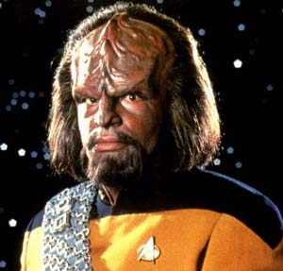

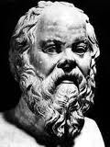
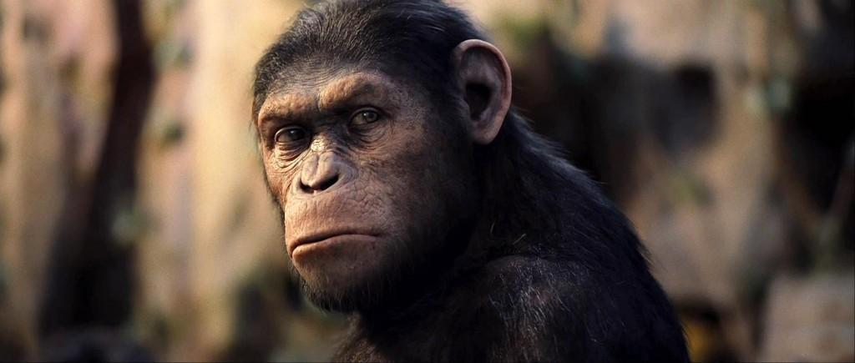
Humanity applies to all rational beings …

Slide 20
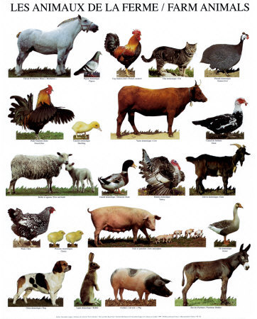
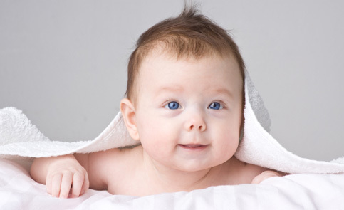

But not to non-rational beings …

Slide 21
The Moral Standing Objection
The principle cannot explain why those who lack rationality and autonomy are deserving of respect.
If the principle of humanity is true, then animals have no rights.
If animals have no rights, then it is morally acceptable to torture them.
Therefore, if the principle of humanity is true, then it is morally acceptable to torture animals.
It isn’t morally acceptable to torture animals!
Therefore, the principle of humanity is false.

Slide 22
Summary& Kingdom of Ends Formulation
Kant’s Categorical Imperative

Slide 23
Big picture
Formula of Universal Law
Objections
“Act only according to that maxim by which you can at the same time will that it should become a universal law of nature.”
Rigorism
Sneaky Maxim Maker / Vacuous
Covert Consequentialism

Slide 24
Big picture
Formula of Universal Law
Question
“Act only according to that maxim by which you can at the same time will that it should become a universal law of nature.”
What are the rational will’s wider purposes?

Slide 25
Big picture
Formula of Humanity
Question
“Act so that you treat humanity, whether in your own person or in that of another, always as an end and never as a means only.”
How do you respect the ends of others?

Slide 26
Big picture
The Kingdom of Ends
Kant’s CI
“So act as if you, by your own maxims, were at all times a legislative member in the universal realm of ends.”
Kingdom of ends
“A systematic union of rational beings by common objective laws.”
Self-Legislation
We, as rational agents, legislate the law to which we are subject.
Co-Legislation
Our maxims must be consistent with “the idea of the will of every rational being as a will giving universal law.”

Slide 27
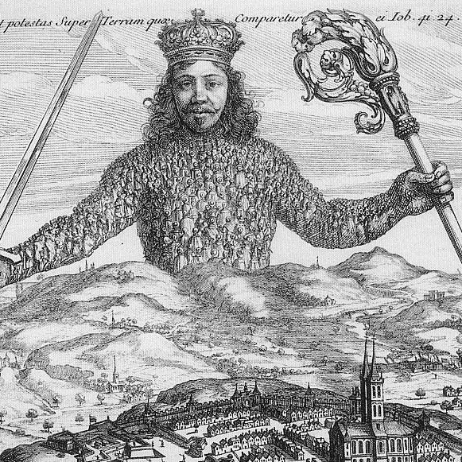
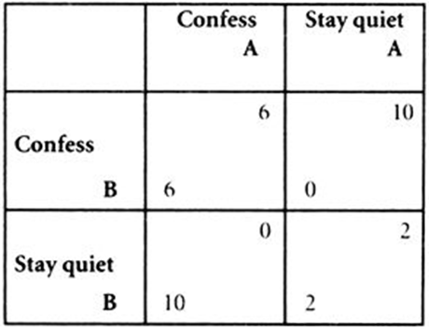
Social Contract
State of Nature
Individually rational to not cooperate
Collectively rational to cooperate

Slide 28
Social Contract
We are rationally required to leave the state of nature and submit to a coercive authority in order to adjudicate between conflicts of individual interests.

Slide 29
Social Contract
Rationality
Autonomous or Heteronomous?

Slide 30
Kant’s Categorical Imperative
Strongly Agree
Agree
Somewhat Agree
Neutral
Somewhat Disagree
Disagree
Strongly Disagree

